Slide 1
Fanfare: The Quest for Windows 9
by
Team Voltron
Phillip Powell, Gabriella Garcia,
Joseph Camacho-Terrazas, Xiana Lara

Slide 2
Project Overview
After many team meetings, we had to scrap our initial project as it was very out of scope and have decided to make a Pewdiepie fan game...kind of. Our 2D platformer will be based on Felix’s Minecraft Server and our NPC’s will be his pets throughout the series, and you are on a mission to find Windows 9 for ultimate internet fame! However we will be adding our personal twist to the game. In Level 1, you will be traveling through 4 different Minecraft Biomes fighting random mobs and collecting items until you reach Pewdiepie’s home, which will be a safe zone as you travel through the nether portal. Once you travel into the Nether (level 2), you need to fight your way through as you search for the illusive Windows 9 OS. Just when you think you’ve found your way to internet fame, who other than Pewds himself appears to fight you for the almighty internet fame!

Slide 3
Key Architectural Drivers
Client/Server: We are making a game that we make available from our server, available to our clients (players!).
We decided to use this because a lot of games are pushed to a server where players (clients) can access the game. It also makes it easier for us to throw the game on a server, and since we don’t want a paywall, publish/subscribe makes no sense.

Slide 4
Architectural Style Choices
Publish-Subscribe
Once the client has purchased the game, they are subscribed to it and receive updates for the game.
They can also purchase a season pass, where they are subscribed to DLC (downloadable content).
Client-Server (Our Choice)
We can have a central server where we host our game and all necessary updates + DLC.
Also allows us to implement multiplayer/co-op in the future.
We can possibly even plan for cloud gaming.

Slide 5
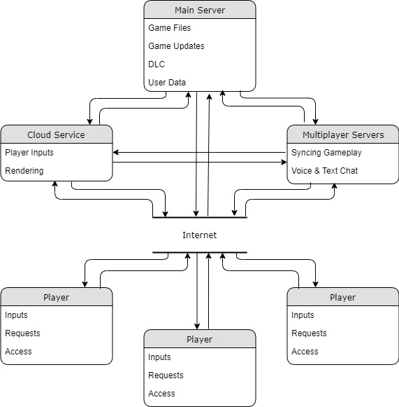
Our Architecture

Slide 6
Conclusion
We agree the Server-Client Architecture is best suited for our game
We can expand the game with multiplayer later on.
We can also consider cloud services and cloud gaming.
We won’t have our players pay extra for extra content.
Issues
Cost of implementation.
Scope.
Most likely easier ways to achieve our goals.

